Slide 1

Web scraping to gain company insights
19/08/2023

Slide 2
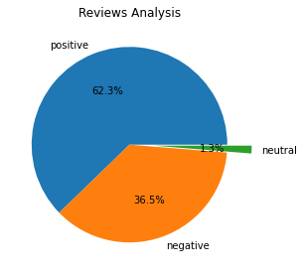
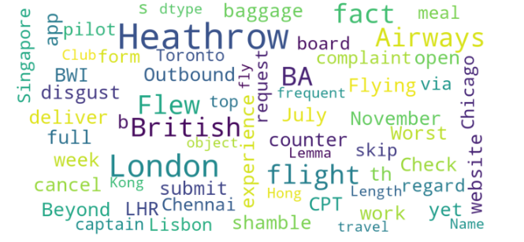
INSIGHTS FROM CUSTOMER REVIEWS
From cleaning 2100 reviews given by the customers, we obtained
Positive Reviews - 1308
Negative Reviews - 766
Neutral Reviews – 27
Word cloud of keywords used in reviews
The Analysis shows that about 62.3% reviews are positive while 1.3% are neutral rest are negative

Slide 3
Sentimental heatmap

